Slide 1
The Battle of Neighborhood
Classification of Most common places of Mumbai and Delhi area
By
Kamlesh Patani

Slide 2
Introduction
Mumbai and Delhi are two major cities in India. Both cities become a center of attention for residential, job employment, tourism, education, shopping and sports activity. Both cities are well known in India, and become the top choice for local and foreign communities.

Slide 3
Objective
In this project, we study in details the area classification using Foursquare data and machine learning segmentation and clustering.
The aim of this project is to segment areas of Mumbai and Delhi based on the most common places captured from Foursquare.
Using segmentation and clustering, we hope we can determine:
1. the similarity or dissimilarity of both cities
2. classification of area located inside the city whether it is residential, tourism places, or others

Slide 4
Data
The data acquired from government website and restructure to csv file for easier manipulation and reading. This files uploaded to my github for references. Link to the files are:
[Mumbai District Data](https://github.com/kamleshpatani/Coursera_Capstone/blob/master/all_india_PO_list.csv)
[Delhi District Data](https://github.com/kamleshpatani/Coursera_Capstone/blob/master/all_india_PO_list.csv)
Another aspect to consider for this project is the Foursquare data. I believe that the data as good as provided, meaning although we are using Foursquare data for segmentation and clustering, the amount and accuracy of data captured can't 100% determine correct classification in real world.

Slide 5
Methodology
We have converted addresses into their equivalent latitude and longitude values. Then we will use the Foursquare API to explore neighborhoods in both cities, Mumbai and Delhi After that, explore function to get the most common venue categories in each neighborhood, and then use this feature to group the neighborhoods into clusters
K-means clustering algorithm will be use to complete this task. And also, the Folium library to visualize the neighborhoods in Mumbai and Delhi and their emerging clusters.
Based on dataframe analysis above, we found out that Mumbai in Mumbai Region and Delhi area in Delhi are both have the highest number of area within it those district.

Slide 6
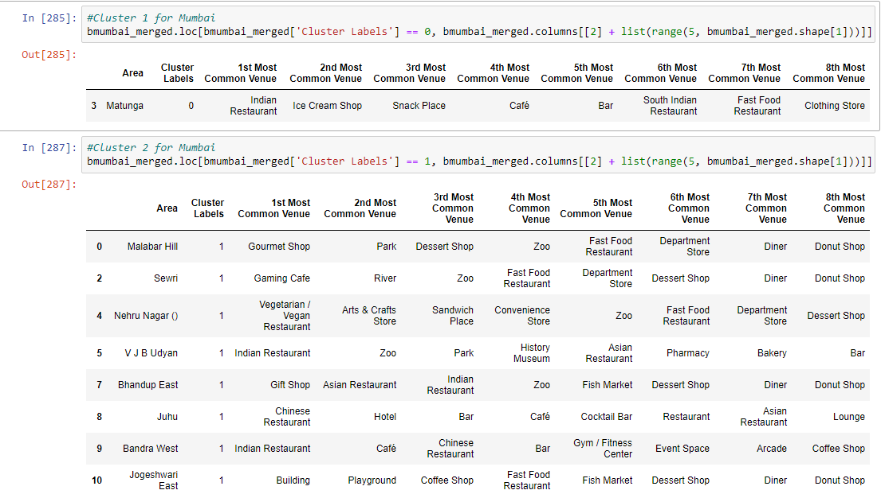
Result
the following is the result we have got for Mumbai and Delhi

Slide 7
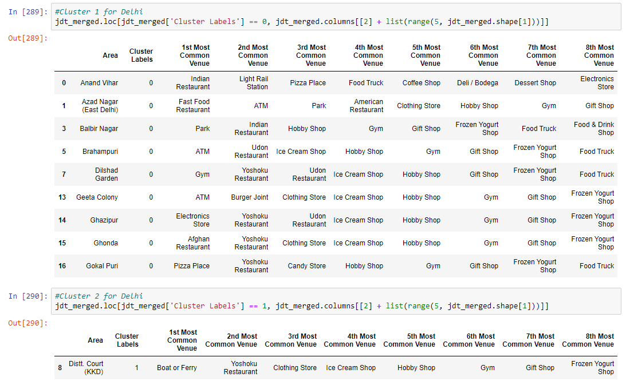
Result

Slide 8
Conclusion
we can captured data of common places to determine
the similarity or dissimilarity of both cities
classification of area located inside the city whether it is residential, tourism places, or others
In conclusion, both cities Mumbai and Delhi are the center of attraction among Indian. However, to declare both cities are similar or dissimilar base on common venues visited is quite difficult.
Both cities is similar in some venues also dissimilar in certain venues. And for classification based on common venues, again we must have more systematic or quantitative way to identify and declare this.
Comparison can be made, but no such method or quantitative data to determine this. We hope in the future, a method to determine it can be establish and explore for references.

